Slide 1
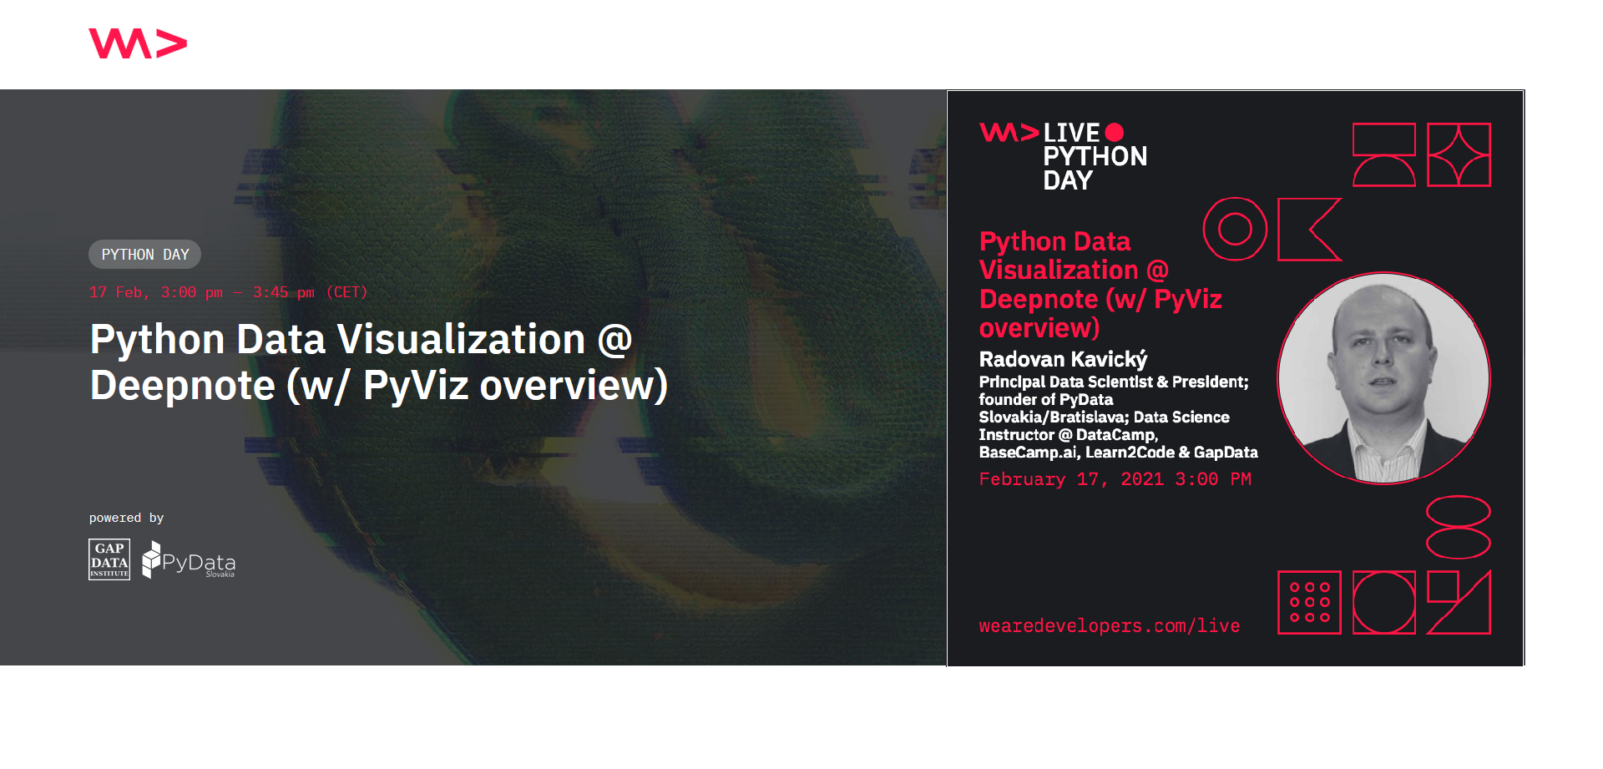

Python Data Visualization @ Deepnote (w/ PyViz overview)
#WeAreDevs #WeAreDevsLIVE
17. 2. 2021
Radovan Kavický, GapData Institute & PyData Slovakia #PythonDay
Notes:
1. Introduction, History of Data Science & Why Python for Data Science?/Motivation (5-8 min.)
- Humble Beginnings of Data Science
- What is Data Science & Data Science Workflow
- History of Python & Future of Data Science
2. Main (tools), Where to start & How to do it? (10-12 min.)
- Python & Data Science (IDE-s and tools)
- Why should people care? (PyData Worldwide & PyData movement/educational programme)
3. PyData Bratislava (where we were/are & our activities), Partners, Meetups & Conferences (2-5 min.)
4. Conclusion (the end of talk +vision), Potential & Results (2-5 min.)
- Future of Data Science (in/outside Python)
- Data-Driven Approach. Everywhere. Now. (Citizen Data Science)

Slide 2
Talk Structure
1. Introduction, History of Python, DataViz & Data Science + Why Python?/Motivation (8-10 min.)
- Humble Beginnings of Data Visualization & Science
- What is Data Science & Data Science Workflow
- Data Visualization Landscape
2. Data Visualization in Python (tools), Where to start & How to do it? (10-12 min.)
- Data Visualization in Python (PyData & PyViz overview)
- Why should people care? (PyData Worldwide & PyData movement/educational programme)
3. Common DataViz Problems and pitfalls/mistakes (and how to resolve them) (8-10 min.)
4. Conclusion (the end of talk +vision), Potential (our activities, partners, meetups) & Results (2-5 min.)
- Future of Data Visualization & Science (AI/ML/NLP in/outside Python) (1-2 min.)
5. Discussion/Q&A (5-6 min.)
Slides (this talk) > tiny.cc/WeAreDevsPython2021, Deepnote (Live-Code) > http://bit.ly/PythonDayDeepnote
Slides & code (later today) https://github.com/radovankavicky/WeAreDevs2021
Python Data Visualization @ Deepnote (w/ PyViz overview)
1/16 #PythonDay @ sli.do
Notes:
1. Introduction, History of Data Science & Why Python for Data Science?/Motivation (5-8 min.)
- Humble Beginnings of Data Science
- What is Data Science & Data Science Workflow
- History of Python & Future of Data Science
2. Main (tools), Where to start & How to do it? (10-12 min.)
- Python & Data Science (IDE-s and tools)
- Why should people care? (PyData Worldwide & PyData movement/educational programme)
3. PyData Bratislava (where we were/are & our activities), Partners, Meetups & Conferences (2-5 min.)
4. Conclusion (the end of talk +vision), Potential & Results (2-5 min.)
- Future of Data Science (in/outside Python)
- Data-Driven Approach. Everywhere. Now. (Citizen Data Science)

Slide 3



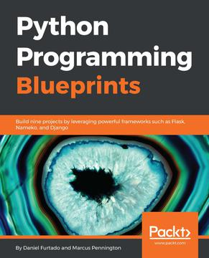


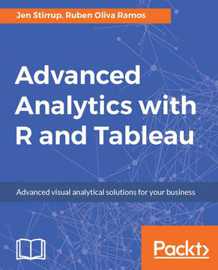
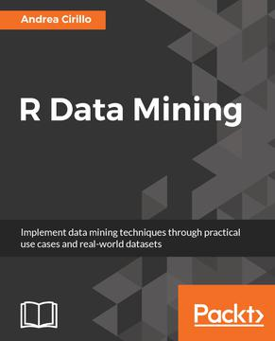
About me
Economist (Macro, Finance); Slovak Economic Association (SEA)
Principal Data Scientist (GapData), Consulting (public, private)
Member of PSF, Slovak.AI, CLAIRE, EU AI Alliance, TAILOR & UDSC
Data Science Instructor @ DataCamp, BaseCamp.ai, Learn2Code
Founder of PyData Slovakia/Bratislava (#PyDataBA), R <- Slovakia (#RSlovakia), Julia Users Group Slovakia (#JUGSlovakia) & SK/CZ Tableau User Group (#skczTUG)
Python Data Visualization @ Deepnote (w/ PyViz overview)
2/16 #PythonDay @ sli.do
Notes:
(1-2 min.)
Basic information about GapData Institute
Economic Research & Public Policy & Data Science think-tank (data-tank)
Data. Think. Change.
GapData Institute (GDI) is a non-profit nonpartisan research institution harnessing power of data & wisdom of economics for public good.
Transparent account (from day #1; SK7383300000002200933920 https://www.fio.sk/ib2/transparent?a=2200933920)
Partnership (openness, transparency)
Contact:
Radovan Kavicky
radovan.kavicky@gapdata.org
+421 949 716 214 (SK)
http://www.linkedin.com/in/radovankavicky
https://gapdata.slack.com/messages/py-data/
https://github.com/radovankavicky
https://github.com/GapData/PyDataBratislava
@radovankavicky, @PyDataBA, @GapDataInst

Slide 4

(Are you/Do you see yourself as) Python Developer or Data Scientist?
ⓘ Start presenting to display the poll results on this slide.
Python Data Visualization @ Deepnote (w/ PyViz overview)
#PythonDay @ sli.do
Notes:
📣 This is Slido interaction slide, please don't delete it. ✅ Click on 'Present with Slido' and the poll will launch automatically when you get to this slide.

Slide 5



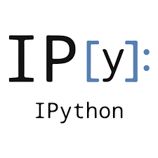
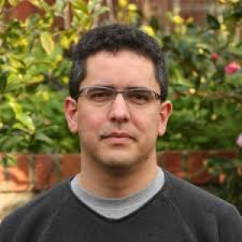

Where & When did Python start?
80’s (idea), December 1989 (beginning), Guido van Rossum (Netherlands/Python is Dutch, CWI Research Institute)
1994 (1.0), 2000 (2.0), 2008 (3.0/3000/Py3K), 2020 (4.0 +end 2.0)
hobby project during holidays
Monty Python Flying Circus
ABC language (cancelled +SETL), Amoeba (OS) needed script language
First PC (ideal), universal a multiplatform+ easy to use, hard to master
Not for data analysis and Data Science (s-l-o-w)
IPython/Jupyter Notebook (Fernando Perez) –JUlia, PYthon, teR
Python Data Visualization @ Deepnote (w/ PyViz overview)
3/16 #PythonDay @ sli.do
Notes:
(1-2 min.)
Basic information about GapData Institute
Economic Research & Public Policy & Data Science think-tank (data-tank)
Data. Think. Change.
GapData Institute (GDI) is a non-profit nonpartisan research institution harnessing power of data & wisdom of economics for public good.
Transparent account (from day #1; SK7383300000002200933920 https://www.fio.sk/ib2/transparent?a=2200933920)
Partnership (openness, transparency)
Contact:
Radovan Kavicky
radovan.kavicky@gapdata.org
+421 949 716 214 (SK)
http://www.linkedin.com/in/radovankavicky
https://gapdata.slack.com/messages/py-data/
https://github.com/radovankavicky
https://github.com/GapData/PyDataBratislava
@radovankavicky, @PyDataBA, @GapDataInst

Slide 6
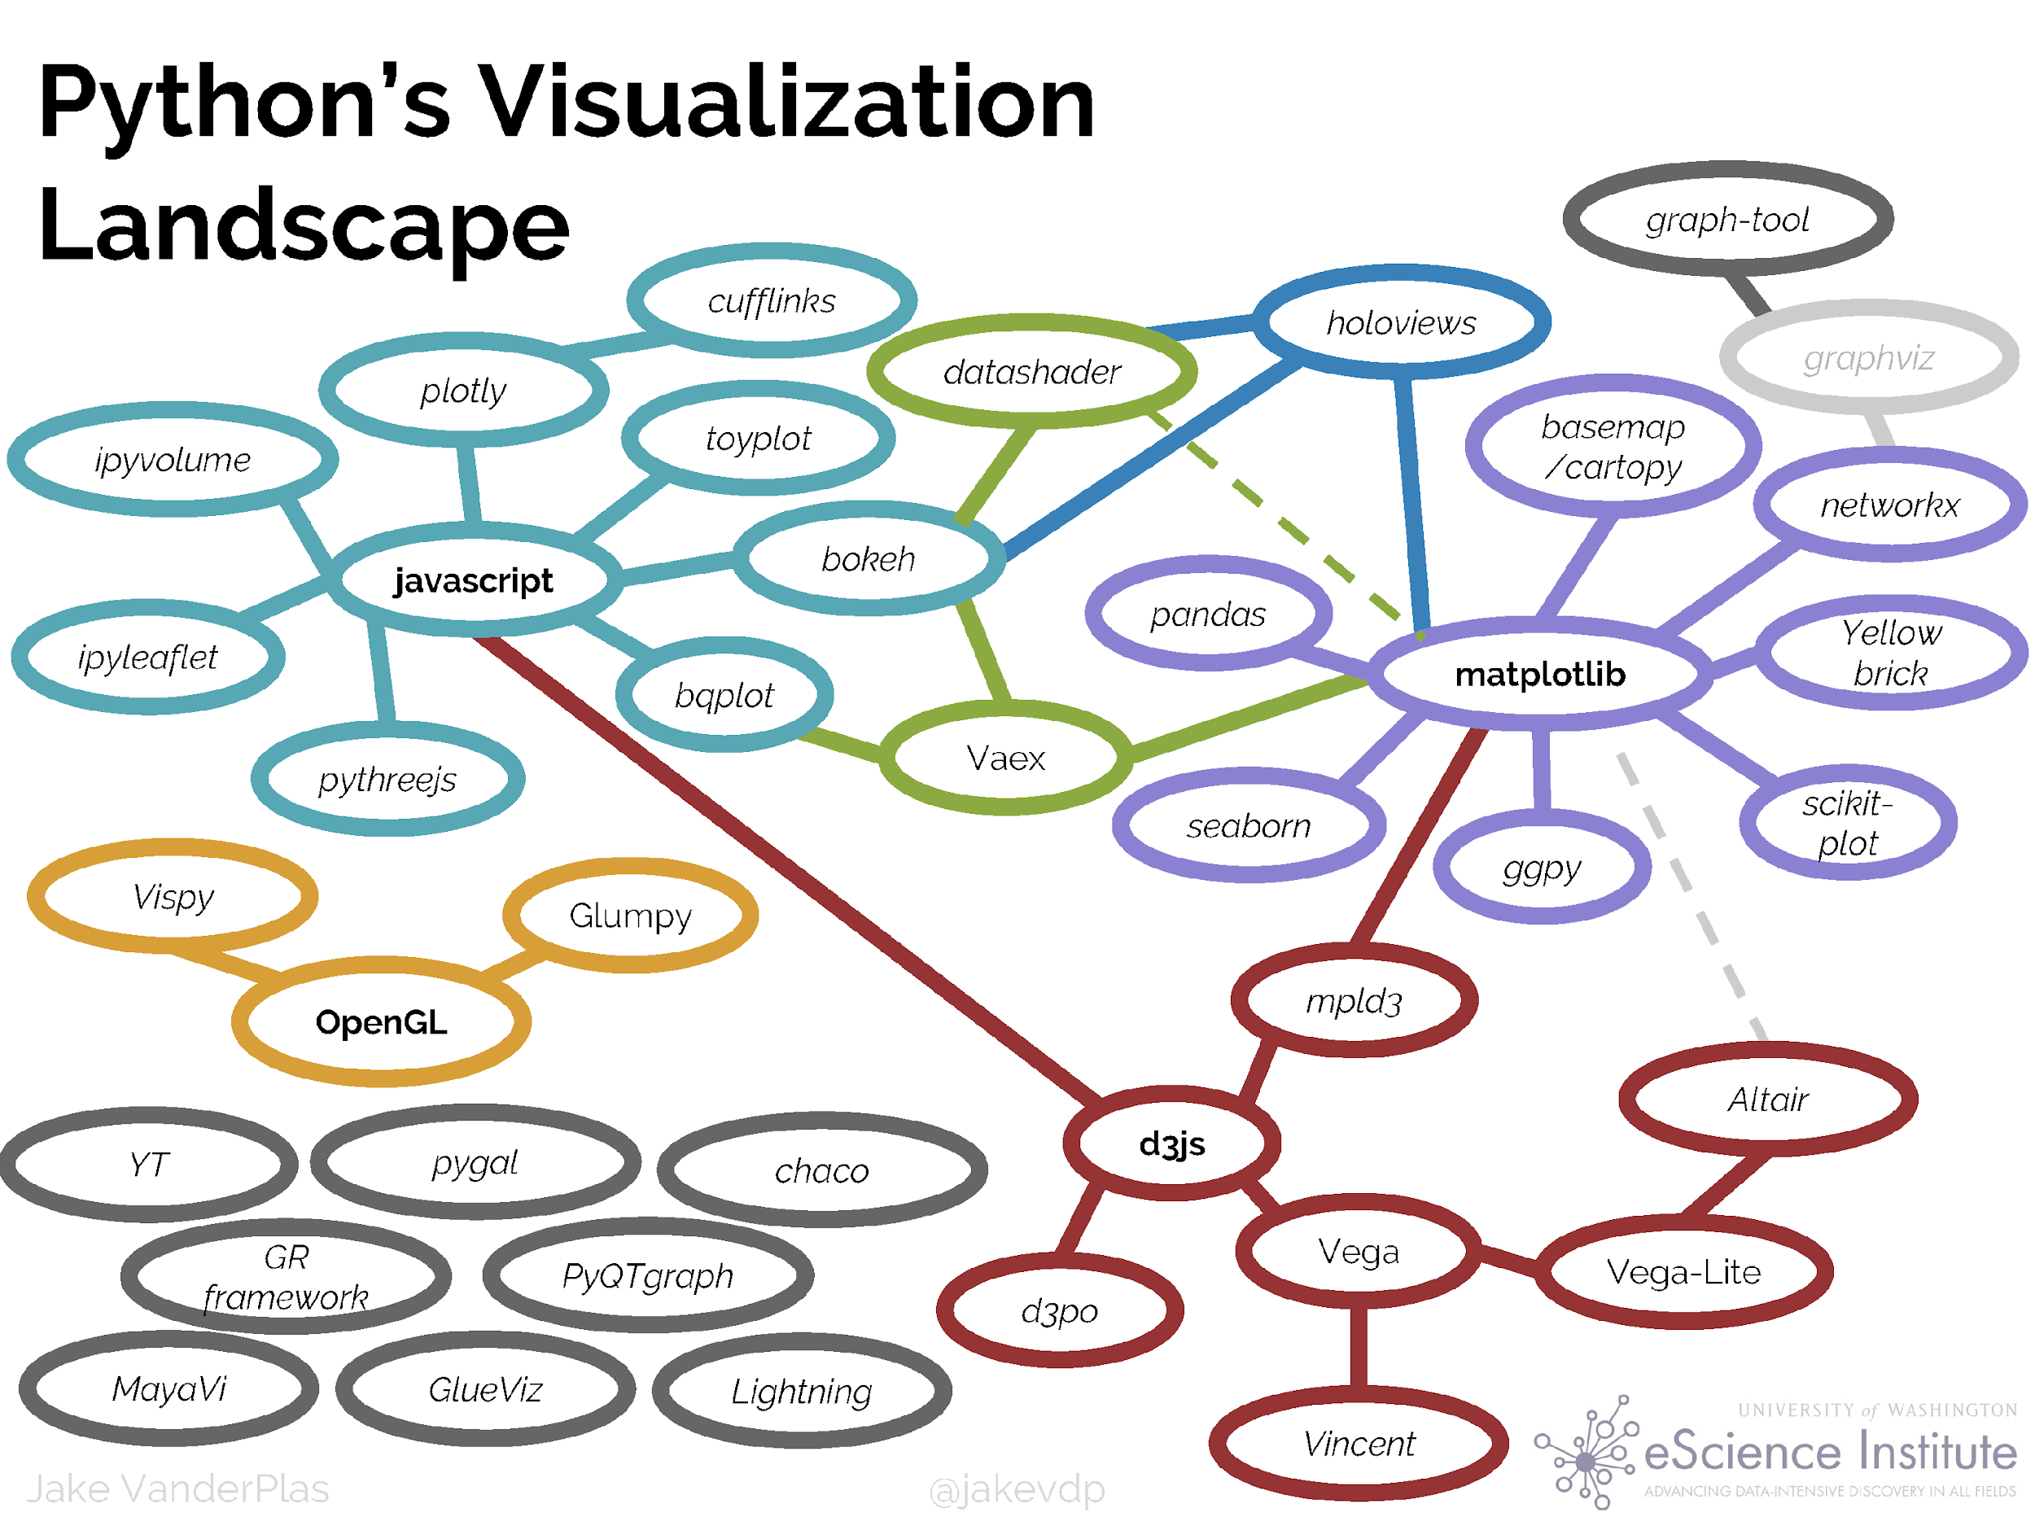
Source: https://speakerdeck.com/jakevdp/pythons-visualization-landscape-pycon-2017, OR https://pyviz.org/overviews/index.html
Python Data Visualization @ Deepnote (w/ PyViz overview)
4/16 #PythonDay @ sli.do

Slide 7
In which area you use Python?
ⓘ Start presenting to display the poll results on this slide.
Python Data Visualization @ Deepnote (w/ PyViz overview)
#PythonDay @ sli.do
Notes:
📣 This is Slido interaction slide, please don't delete it. ✅ Click on 'Present with Slido' and the poll will launch automatically when you get to this slide.

Slide 8
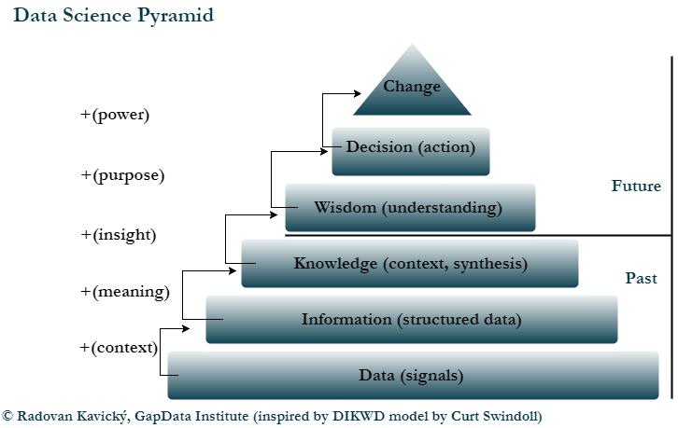
Python Data Visualization @ Deepnote (w/ PyViz overview)
5/16 #PythonDay @ sli.do
Notes:
(1-2 min.)
Basic information about GapData Institute
Economic Research & Public Policy & Data Science think-tank (data-tank)
Data. Think. Change.
GapData Institute (GDI) is a non-profit nonpartisan research institution harnessing power of data & wisdom of economics for public good.
Transparent account (from day #1; SK7383300000002200933920 https://www.fio.sk/ib2/transparent?a=2200933920)
Partnership (openness, transparency)
Contact:
Radovan Kavicky
radovan.kavicky@gapdata.org
+421 949 716 214 (SK)
http://www.linkedin.com/in/radovankavicky
https://gapdata.slack.com/messages/py-data/
https://github.com/radovankavicky
https://github.com/GapData/PyDataBratislava
@radovankavicky, @PyDataBA, @GapDataInst

Slide 9

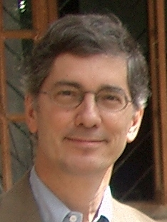
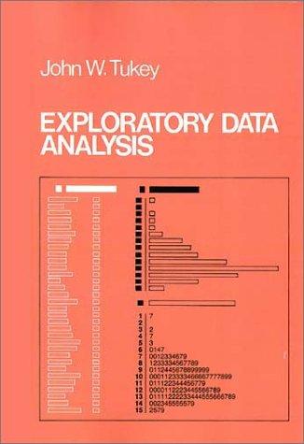
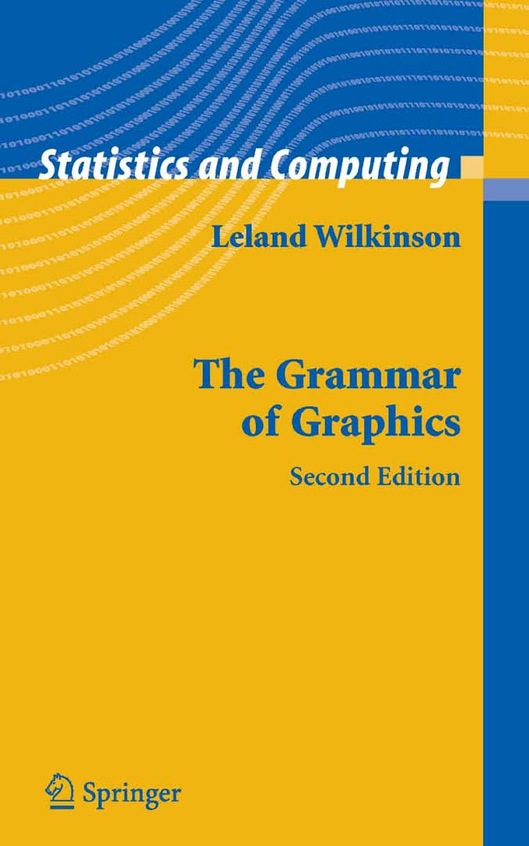
History of Data Science & Data Visualization
John Tukey, Bell Labs (+John von Neumann, 50's), DJ Patil (1st US Chief Data Scientist + Jeff Hammerbacher “coined term Data Science”, 2012)
collection of scientific results and methods for transformation of data from raw form to meaningful information, knowledge and wisdom, which should support better decisions
John W. Tukey (1977), Exploratory Data Analysis
“The greatest value of a picture is when it forces us to notice what we never expected to see.”
Leland Wilkinson (1999, 2005), The Grammar of Graphics (gg, ggplot2)
“This book is not about good taste, practice, or graphic design, however. This book focuses on rules for constructing graphs mathematically and then representing them as graphics aesthetically.”
More on History of Data Science: Donoho, David (2015, Stanford), https://courses.csail.mit.edu/18.337/2015/docs/50YearsDataScience.pdf
Radovan Kavický - Data Science with Python: Past, present and future
https://www.youtube.com/watch?v=8mBI3iioT8A
Python Data Visualization @ Deepnote (w/ PyViz overview)
6/16 #PythonDay @ sli.do
Notes:
(1-2 min.)
Basic information about GapData Institute
Economic Research & Public Policy & Data Science think-tank (data-tank)
Data. Think. Change.
GapData Institute (GDI) is a non-profit nonpartisan research institution harnessing power of data & wisdom of economics for public good.
Transparent account (from day #1; SK7383300000002200933920 https://www.fio.sk/ib2/transparent?a=2200933920)
Partnership (openness, transparency)
Contact:
Radovan Kavicky
radovan.kavicky@gapdata.org
+421 949 716 214 (SK)
http://www.linkedin.com/in/radovankavicky
https://gapdata.slack.com/messages/py-data/
https://github.com/radovankavicky
https://github.com/GapData/PyDataBratislava
@radovankavicky, @PyDataBA, @GapDataInst

Slide 10
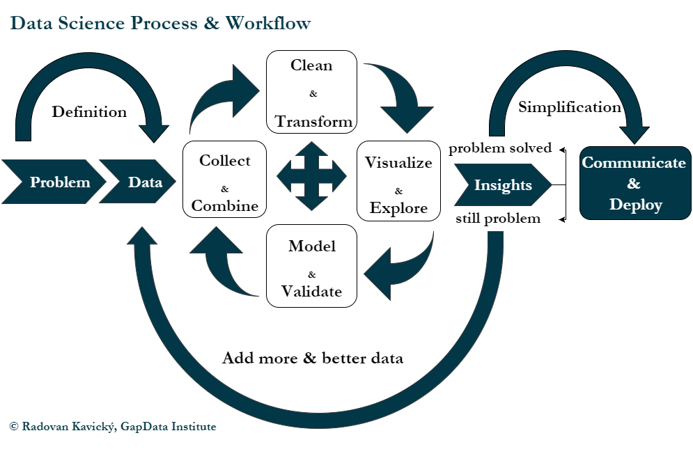
Python Data Visualization @ Deepnote (w/ PyViz overview)
7/16 #PythonDay @ sli.do
Notes:
(1-2 min.)
Basic information about GapData Institute
Economic Research & Public Policy & Data Science think-tank (data-tank)
Data. Think. Change.
GapData Institute (GDI) is a non-profit nonpartisan research institution harnessing power of data & wisdom of economics for public good.
Transparent account (from day #1; SK7383300000002200933920 https://www.fio.sk/ib2/transparent?a=2200933920)
Partnership (openness, transparency)
Contact:
Radovan Kavicky
radovan.kavicky@gapdata.org
+421 949 716 214 (SK)
http://www.linkedin.com/in/radovankavicky
https://gapdata.slack.com/messages/py-data/
https://github.com/radovankavicky
https://github.com/GapData/PyDataBratislava
@radovankavicky, @PyDataBA, @GapDataInst

Slide 11
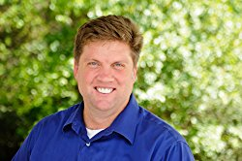
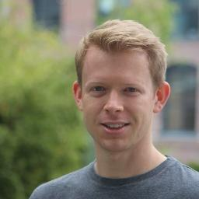

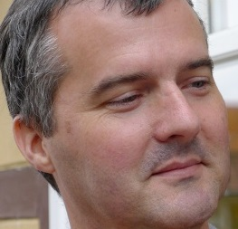




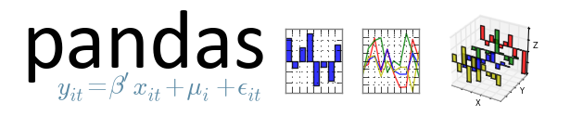
Python Data Visualization (PyData & PyViz overview)
Travis Oliphant (NumPy + SciPy/Matlab alternative)
1995 (Numeric), 2006 (Numpy)
John Hunter (matplotlib) 2003
Wes McKinney (pandas)
January 2008, Python, C, Cython
Anaconda as one of the Python distributions (1000 selected libraries for Data Science)
NumFocus
PyData conferences and local meetups (PyData Bratislava)
Python Data Visualization @ Deepnote (w/ PyViz overview)
8/16 #PythonDay @ sli.do
Notes:
(1-2 min.)
Basic information about GapData Institute
Economic Research & Public Policy & Data Science think-tank (data-tank)
Data. Think. Change.
GapData Institute (GDI) is a non-profit nonpartisan research institution harnessing power of data & wisdom of economics for public good.
Transparent account (from day #1; SK7383300000002200933920 https://www.fio.sk/ib2/transparent?a=2200933920)
Partnership (openness, transparency)
Contact:
Radovan Kavicky
radovan.kavicky@gapdata.org
+421 949 716 214 (SK)
http://www.linkedin.com/in/radovankavicky
https://gapdata.slack.com/messages/py-data/
https://github.com/radovankavicky
https://github.com/GapData/PyDataBratislava
@radovankavicky, @PyDataBA, @GapDataInst

Slide 12

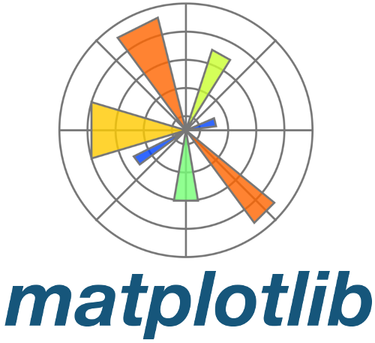
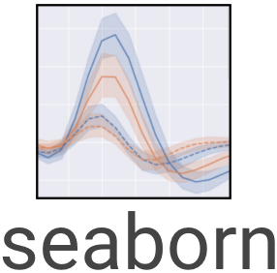



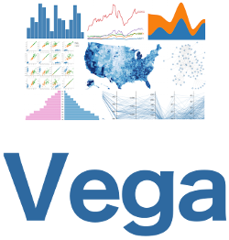


Python Data Visualization (PyData & PyViz overview)
Matplotlib (dataviz/static)
- works well with pandas/included
seaborn (dataviz/static)
- more options than Matplotlib
Altair (dataviz/Vega-based, JSON format)
Bokeh (Python & JavaScript-based, D3-like)
Plotly (JavaScript-based, universal)
Datashader (big data/billions of points/DARPA)
Dash (dashboards in Python)
Python Data Visualization @ Deepnote (w/ PyViz overview)
9/16 #PythonDay @ sli.do

Slide 13
Is Python your only programming language? (pick also another that you use, Julia, R, C, C++, Java, JavaScript, other)
ⓘ Start presenting to display the poll results on this slide.
Python Data Visualization @ Deepnote (w/ PyViz overview)
Notes:
📣 This is Slido interaction slide, please don't delete it. ✅ Click on 'Present with Slido' and the poll will launch automatically when you get to this slide.

Slide 14


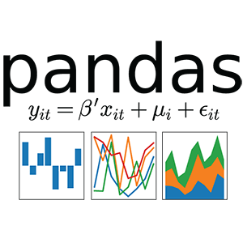


Python & Data Science (tools)
IDE's – Jupyter Notebooks (IPython kernel), PyCharm, JupyterLab
Data Collection – Feather (binary file format/non-csv/Apache Arrow/Wes McKinney), pandas datareader
Data Visualization – Seaborn (matplotlib based/static), Bokeh (interactive/d3.js like), Plotly (declarative dataviz), Altair (static/js)
Data Cleaning & Transform - datacleaner (automate cleaning your data in Pandas), Blaze (NumPy/pandas-like), Dask (parallel computing)
Data Modeling – StatsModels +Patsy (describe statistical models), PyMC3 (Bayes/statistical modeling), Keras (TensorFlow & PyTorch/DL)
Python Data Visualization @ Deepnote (w/ PyViz overview)
10/16 #PythonDay @ sli.do
Notes:
(1-2min.)
Data Collection – Feather (binary file format/non-csv/Apache Arrow/Wes McKinney), Ibis (remote/Hadoop +SQL & bridge it with pandas), ParaText (parallel reading of csv/C++)
Data Visualization – Seaborn (matplotlib based/static), Bokeh (interactive/d3.js like), Plotly (declarative dataviz), Altair (static/js), Geoplotlib (maps)
Data Cleaning & Transform - datacleaner (automate cleanining your data in Pandas), Blaze (NumPy/pandas-like), xarray (pandas-like), Dask (parallel computing)
Data Modeling – StatsModels +Patsy (describe statistical models), PyStan (Bayes/C++), PyMC3 (Bayes/statistical modeling), Keras (TensorFlow/DL)

Slide 15
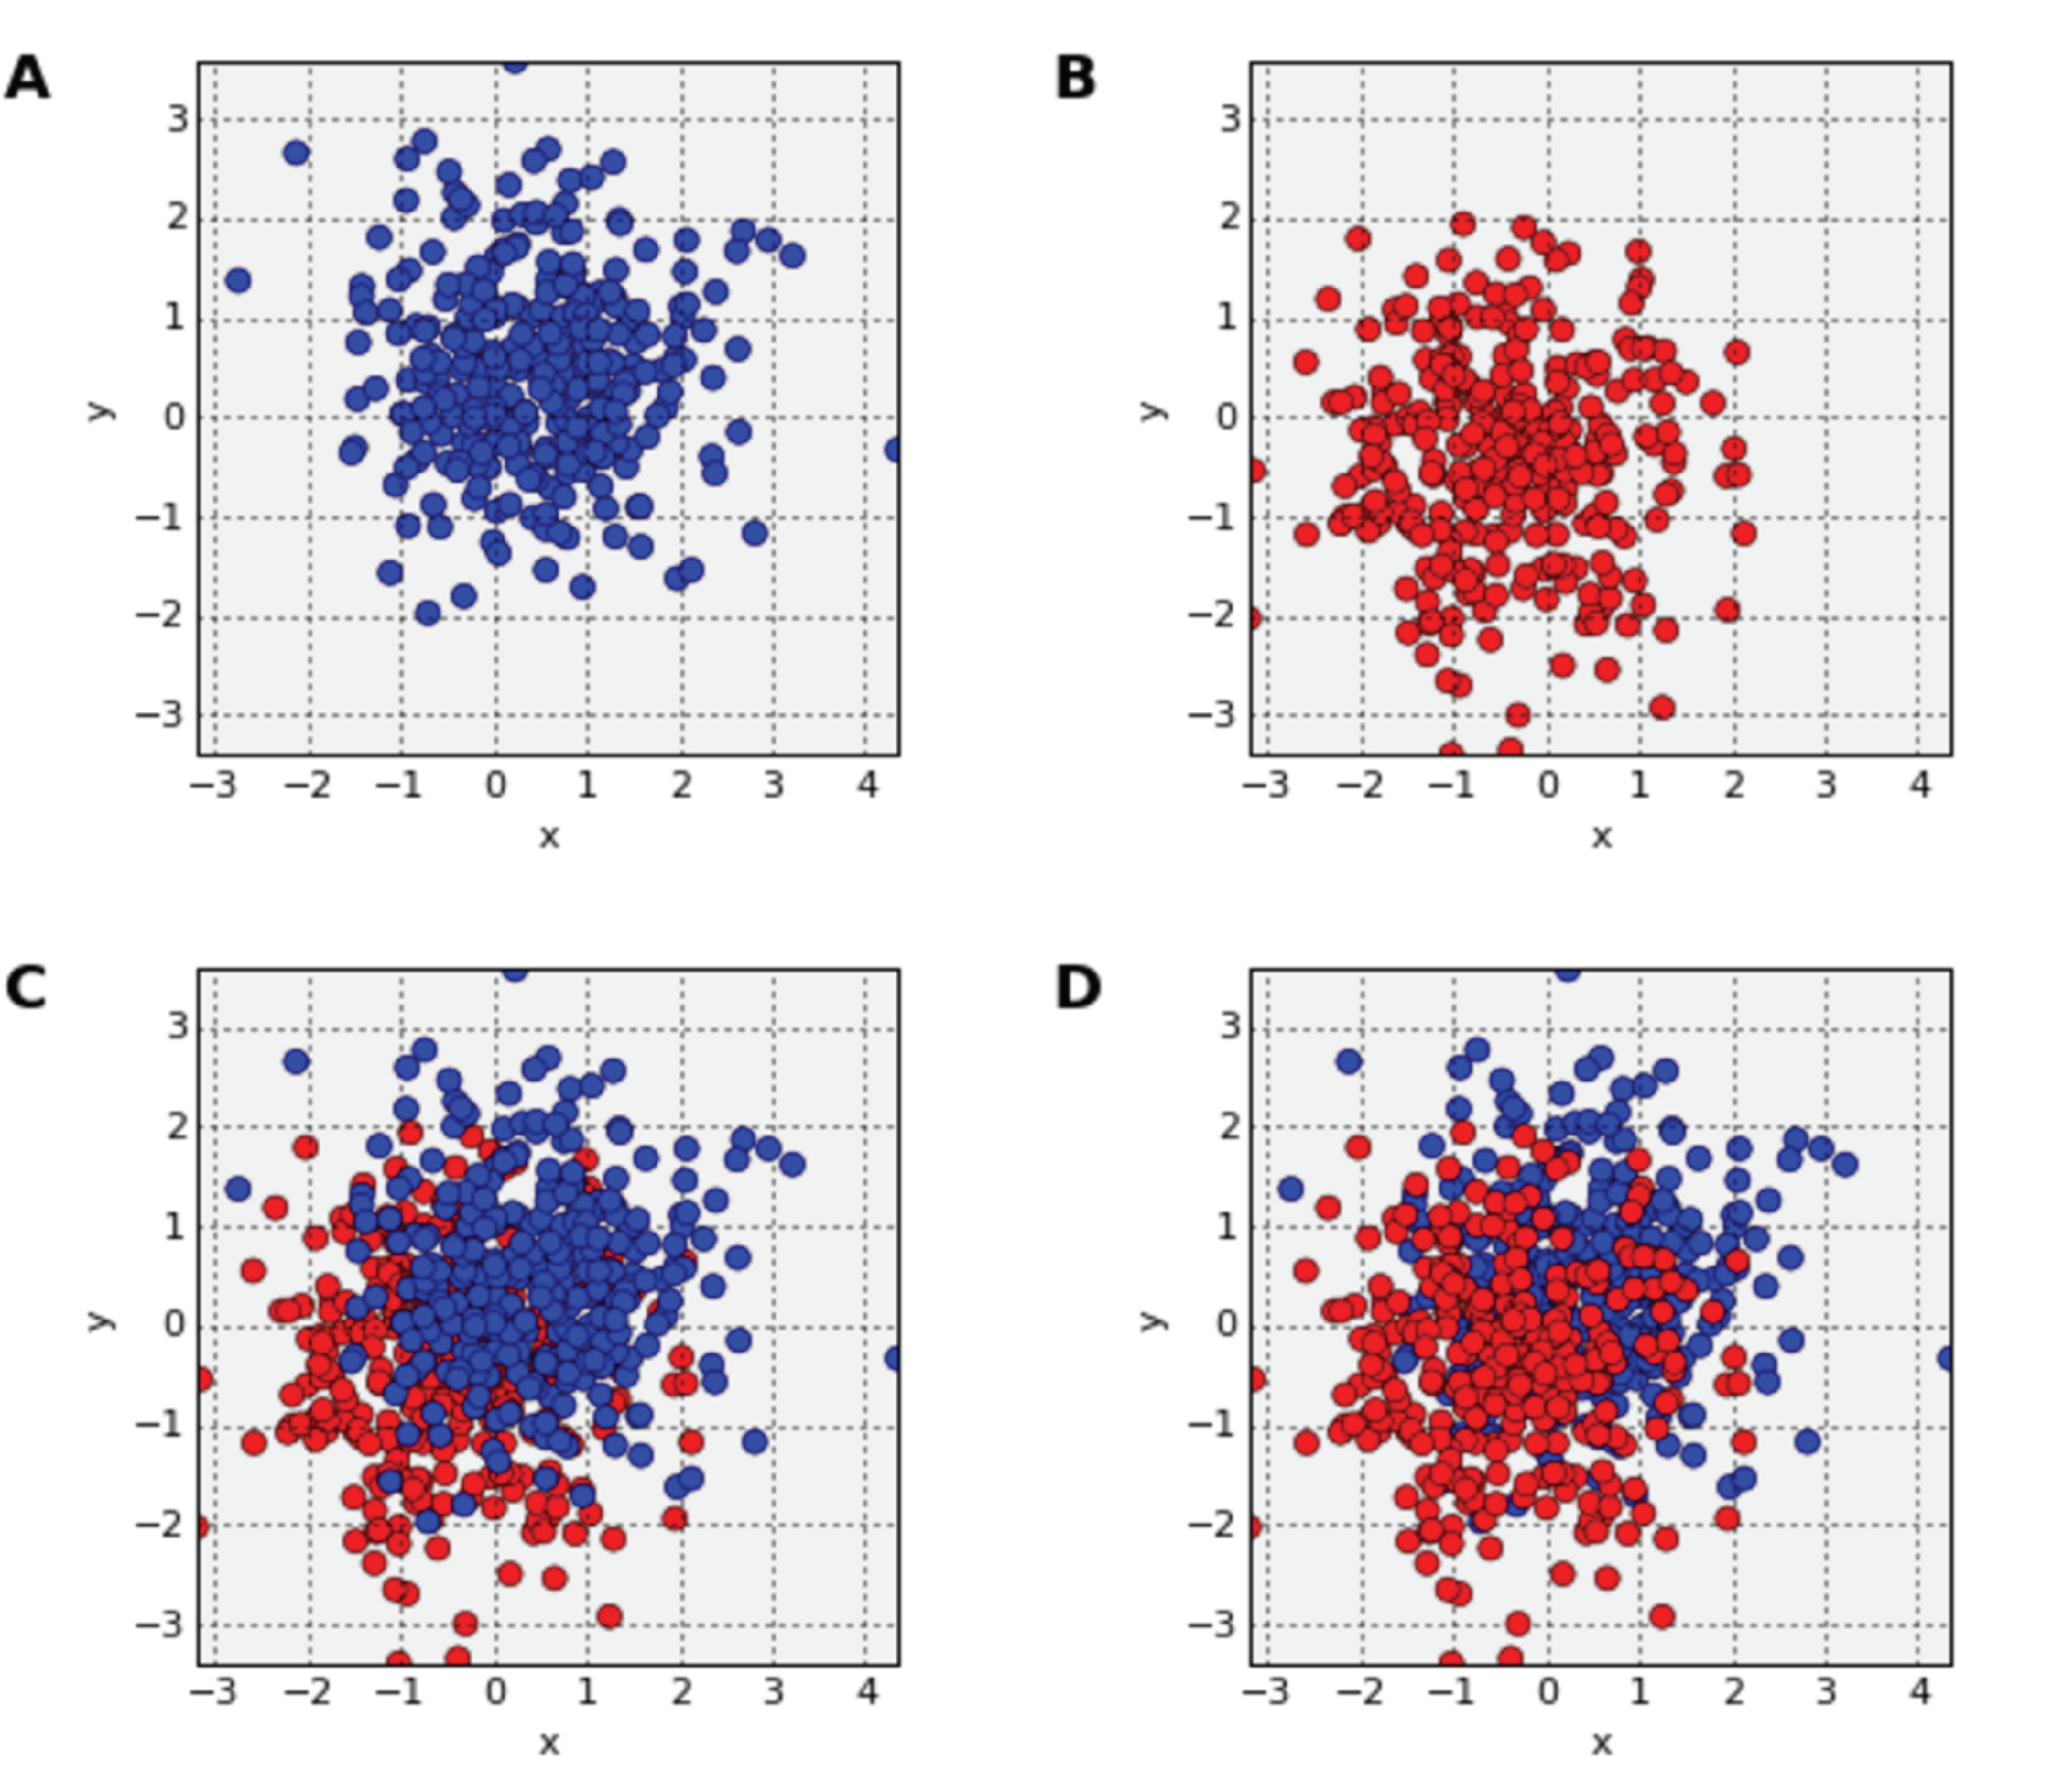
Common data-vis problems (overplotting)
order matters
last data plotted over-plots the previous
Solution:
set alpha/alpha transparency
jittering (add a little random noise to the date)
change shape (data point) or reduce size
remove fill color (for data points)
reduce amount (scale)
Python Data Visualization @ Deepnote (w/ PyViz overview)
11/16 #PythonDay @ sli.do

Slide 16
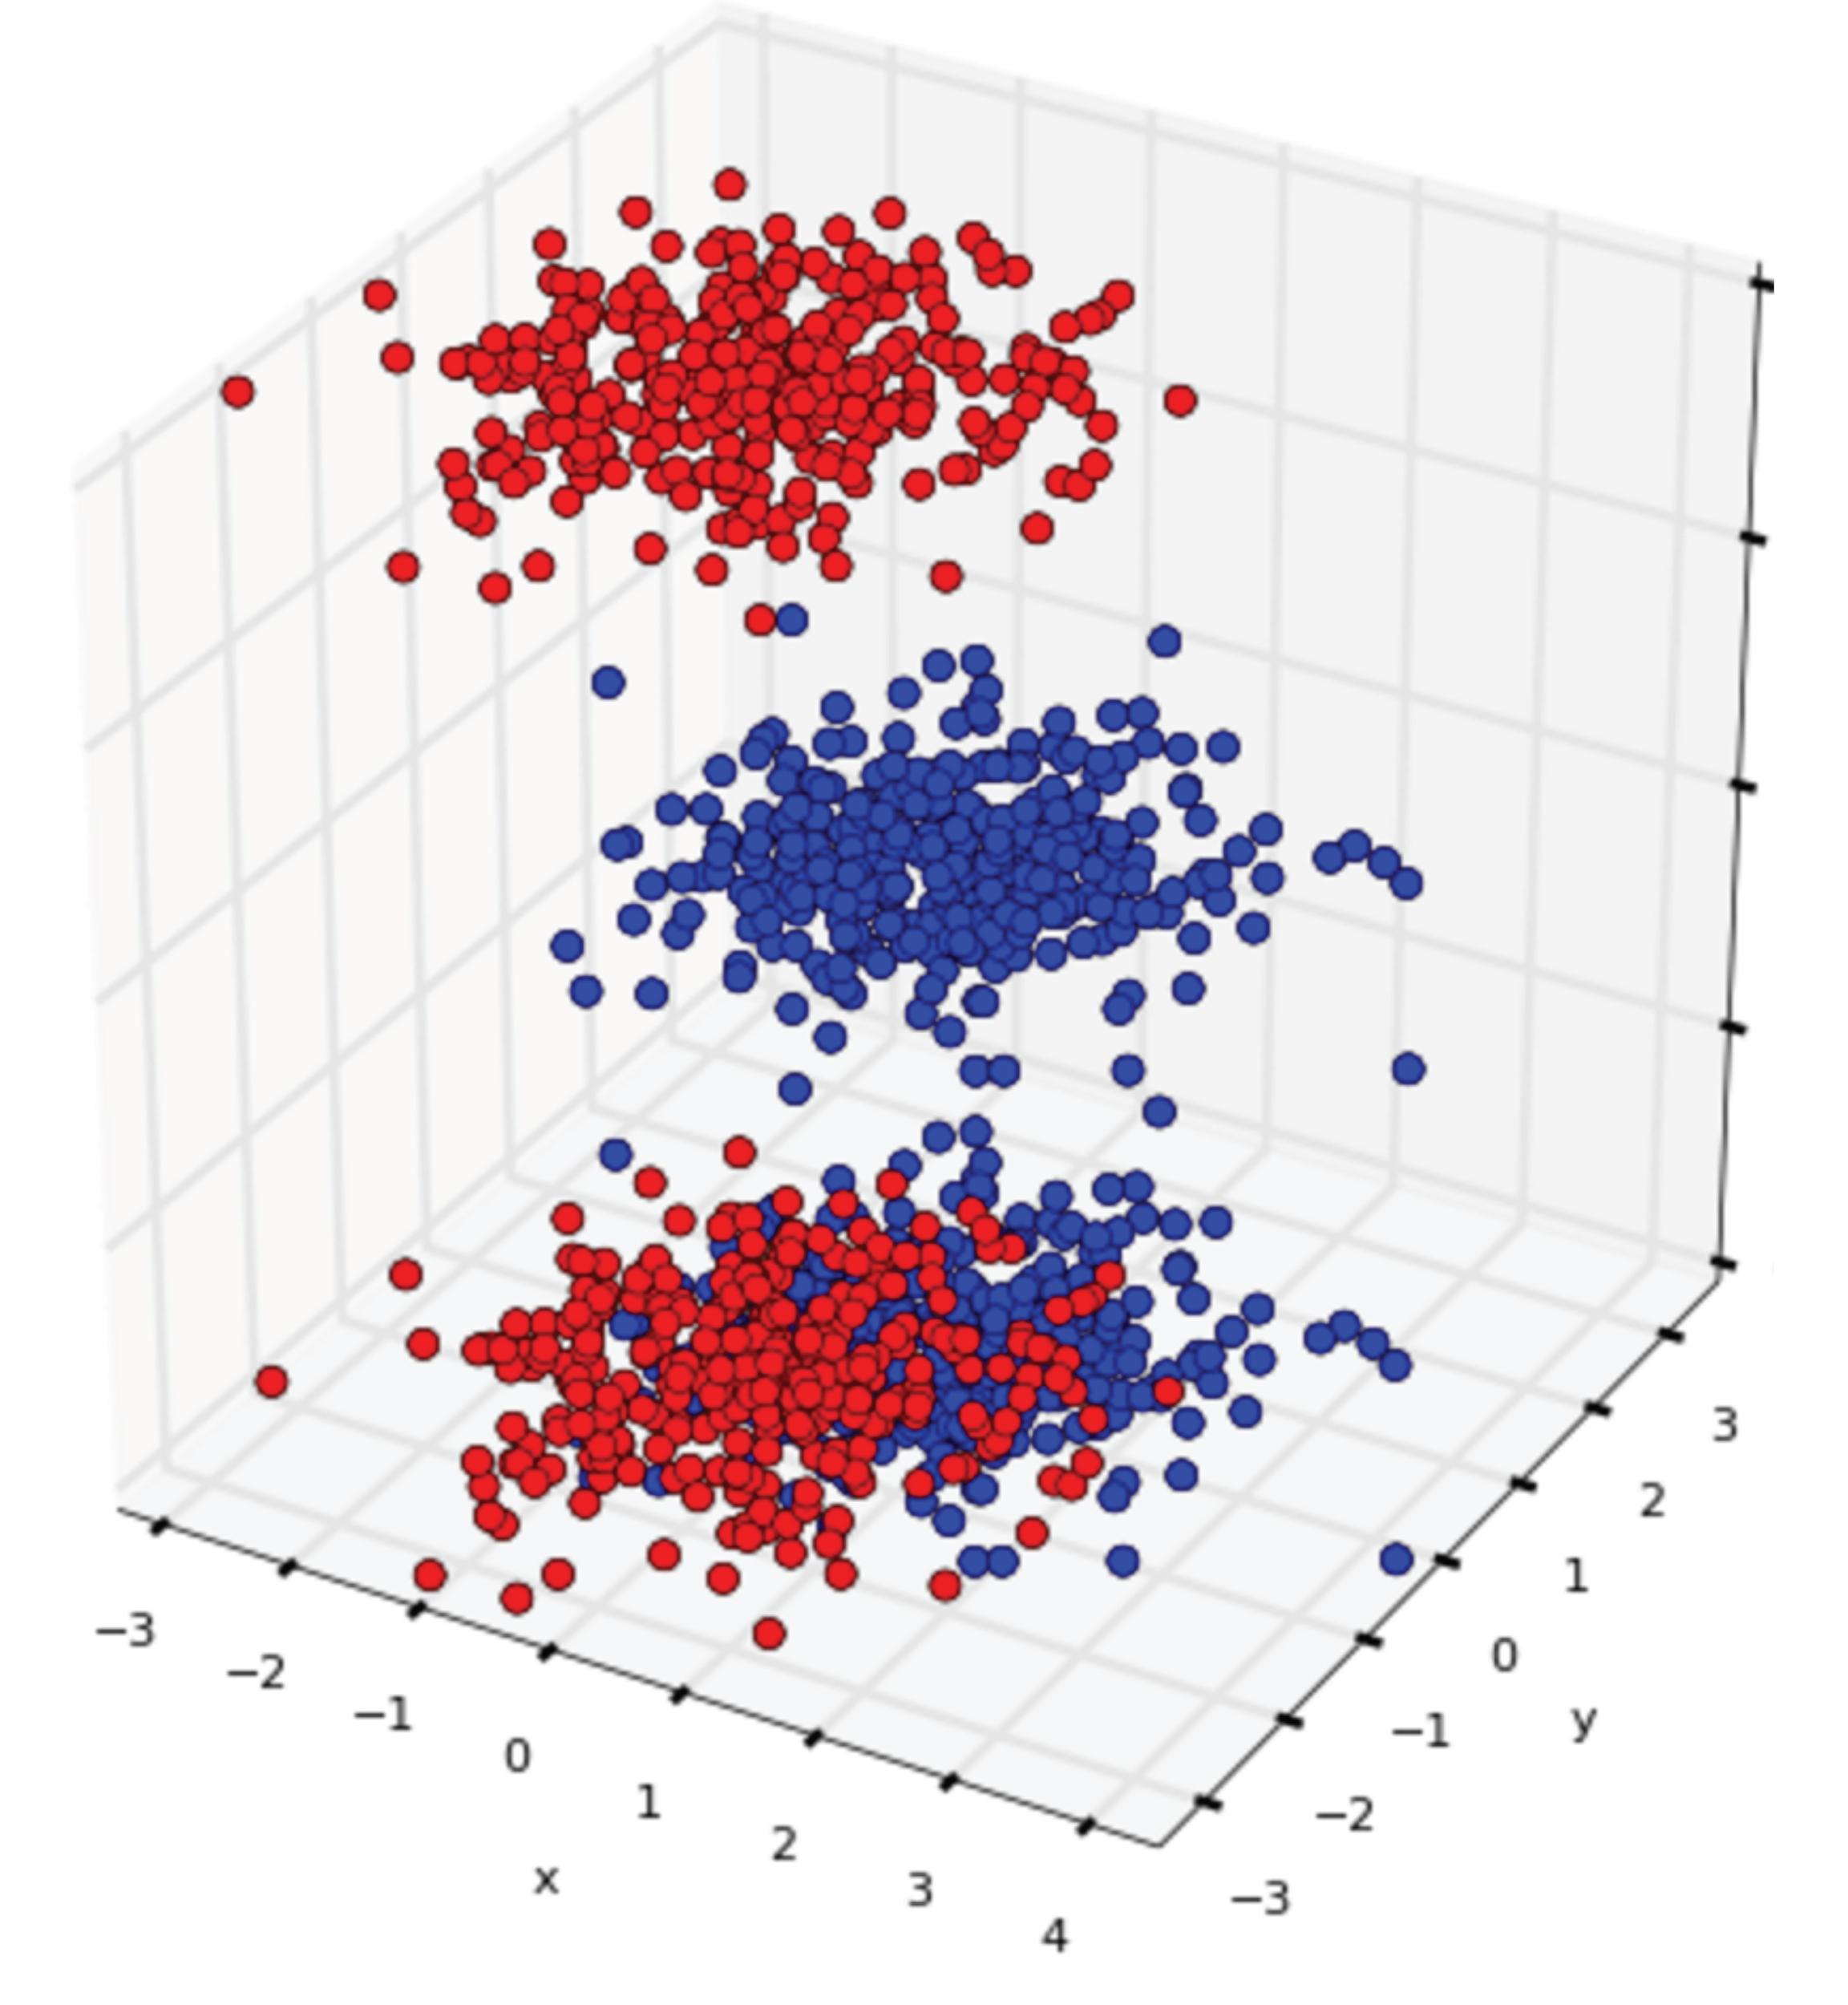
Common data-vis problems (overplotting)
occlusion (visually absorbed information)
typical for 3D datavis (data within the physical space/ behind the object the user is viewing)
Solution:
set alpha/alpha transparency or semi/partial-transparency
rotation (re-plotting)
jittering (mostly useful for 2D)
scale/remove the data plotted
Python Data Visualization @ Deepnote (w/ PyViz overview)
12/16 #PythonDay @ sli.do

Slide 17
Which IDE for Python do you use? (multiple choice/you can select more than one that you use)
ⓘ Start presenting to display the poll results on this slide.
Python Data Visualization @ Deepnote (w/ PyViz overview)
Notes:
📣 This is Slido interaction slide, please don't delete it. ✅ Click on 'Present with Slido' and the poll will launch automatically when you get to this slide.

Slide 18
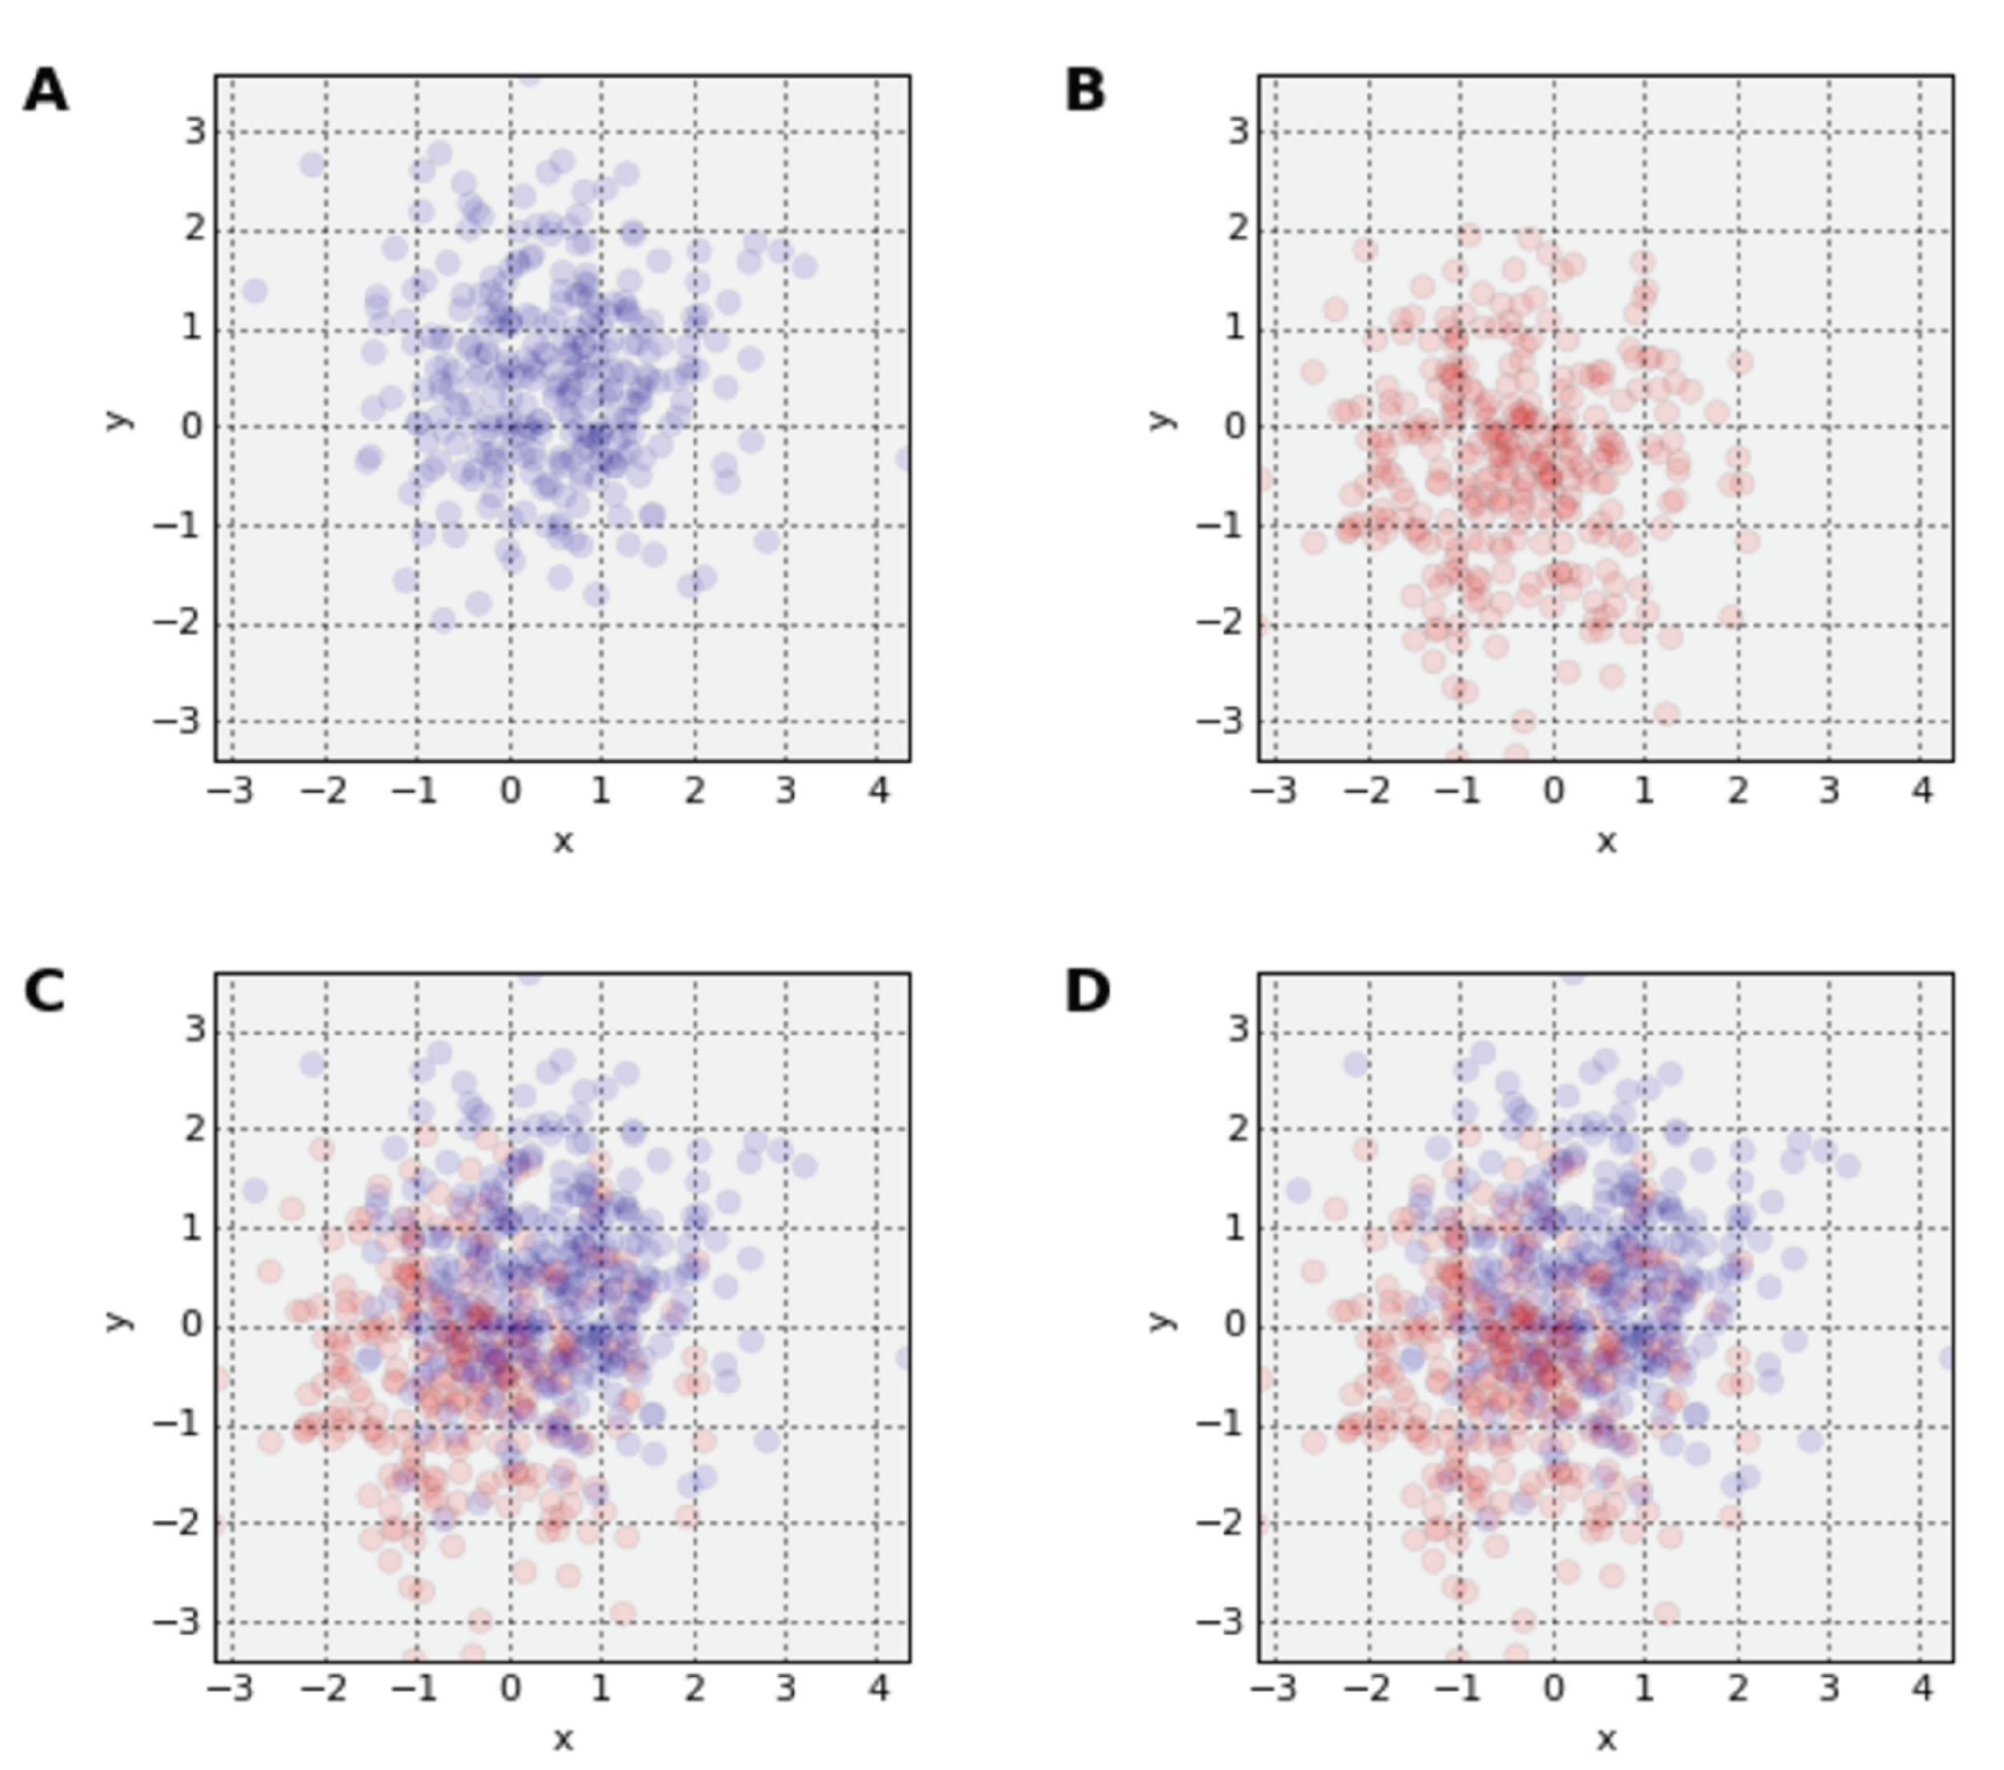
Common data-vis problems (saturation)
intensity of colour
f. e. if you set the alpha to 0.1, you have only about 10 points that can overlap before saturation (+first plotted data loss)
> 10 overlapping points identical
Solution:
smaller points
change shape no fill of data points
Python Data Visualization @ Deepnote (w/ PyViz overview)
13/16 #PythonDay @ sli.do

Slide 19
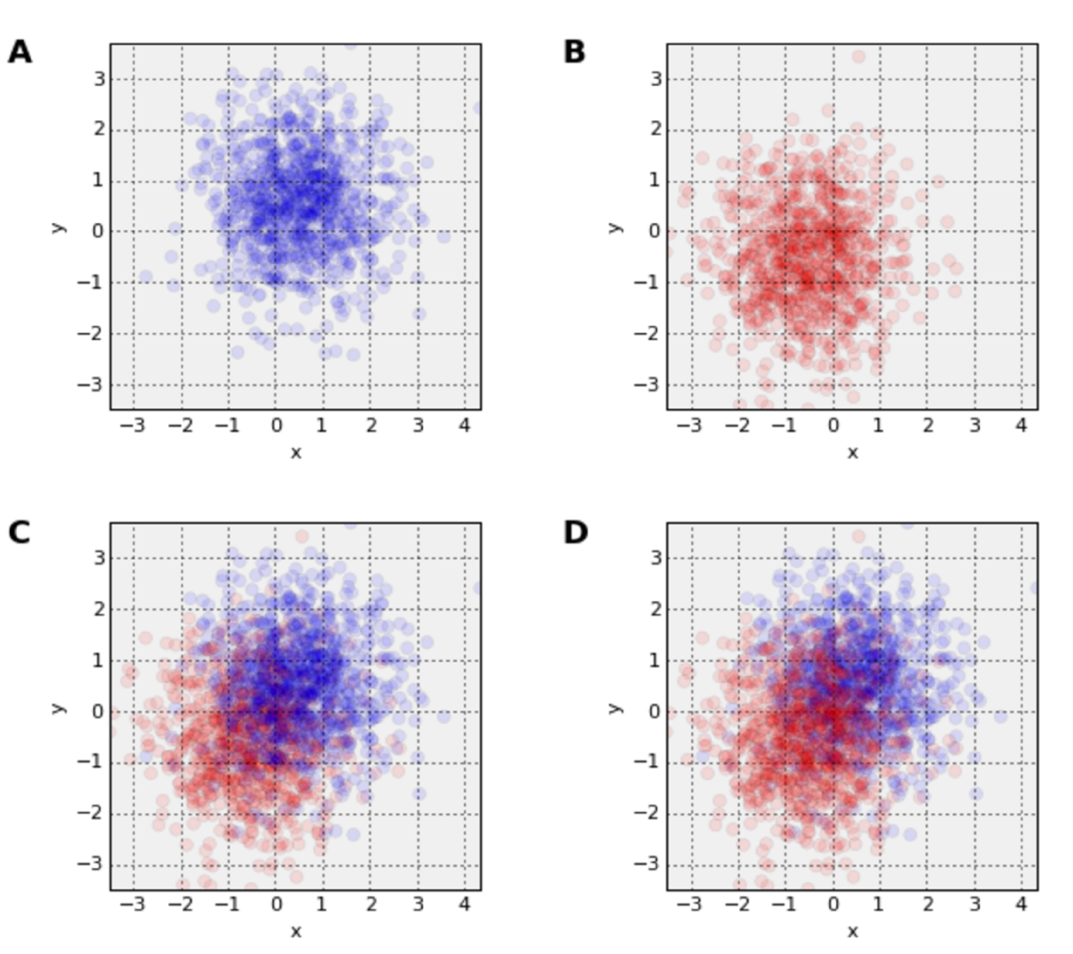
Common data-vis problems (saturation)
with same alpha value, but more points (same problem)
hard to know when the data are misrepresented
Solution:
again smaller points can help (+higher resolution)
although shape and size of the point is tricky to pick
Python Data Visualization @ Deepnote (w/ PyViz overview)
14/16 #PythonDay @ sli.do

Slide 20
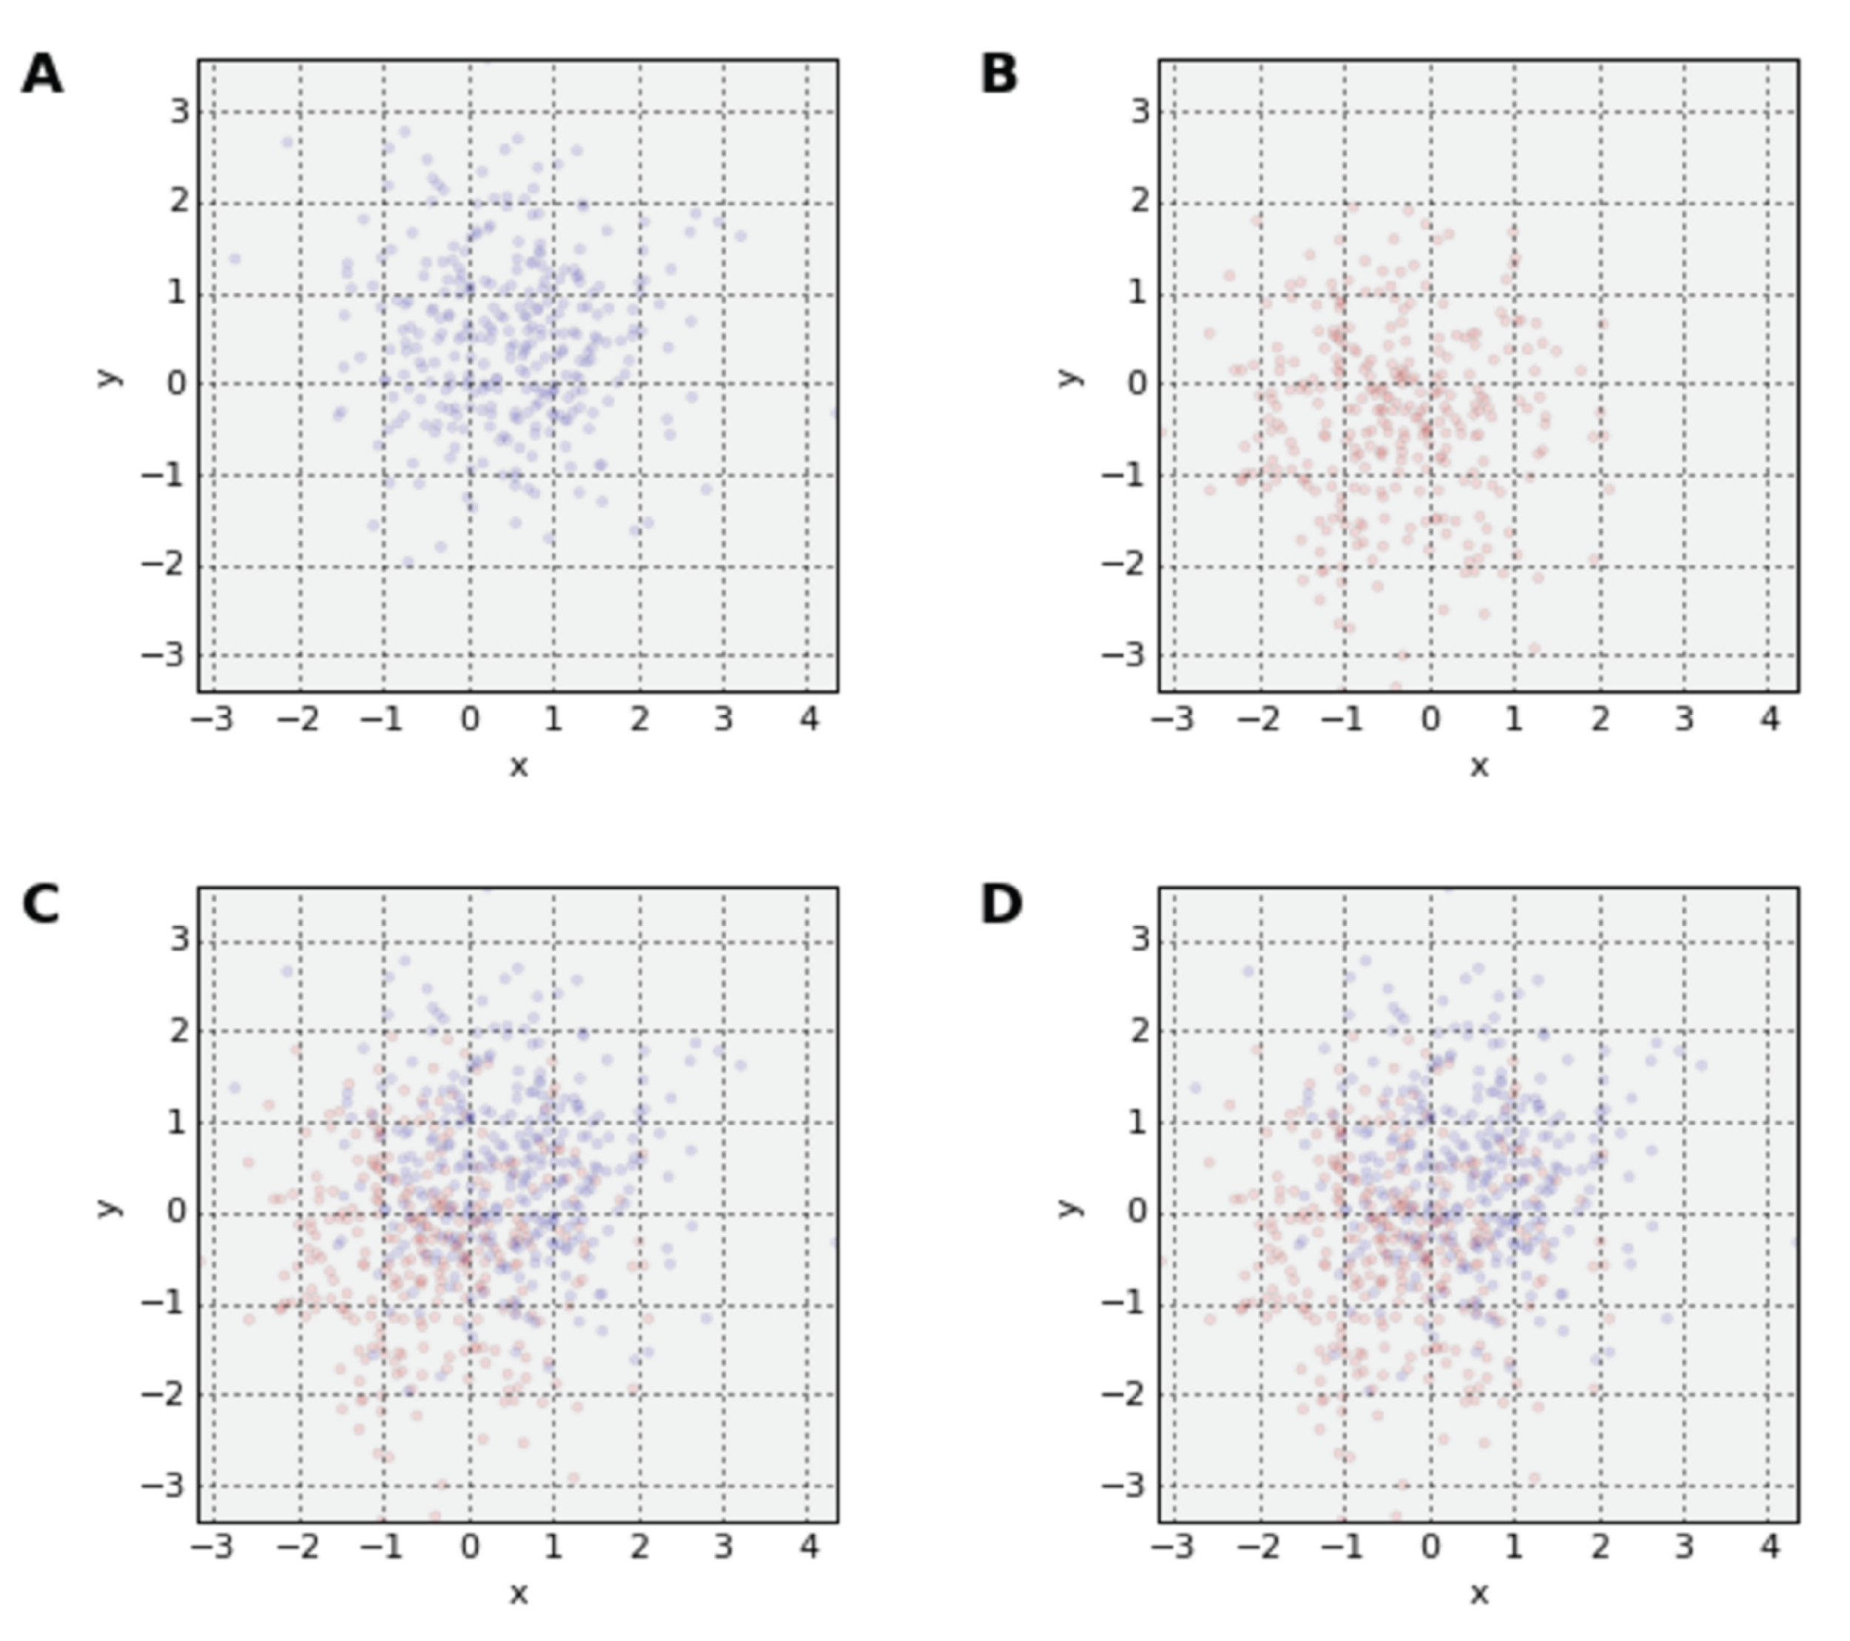
Common data-vis problems (saturation)
smaller points you cannot see clearly
one pixel per data point
Solution:
higher resolution or scaling +different type of visualization, f.e. heatmap
auto-range on pixels (data-shades)
add zooming/interactivity for user
Python Data Visualization @ Deepnote (w/ PyViz overview)
15/16 #PythonDay @ sli.do

Slide 21
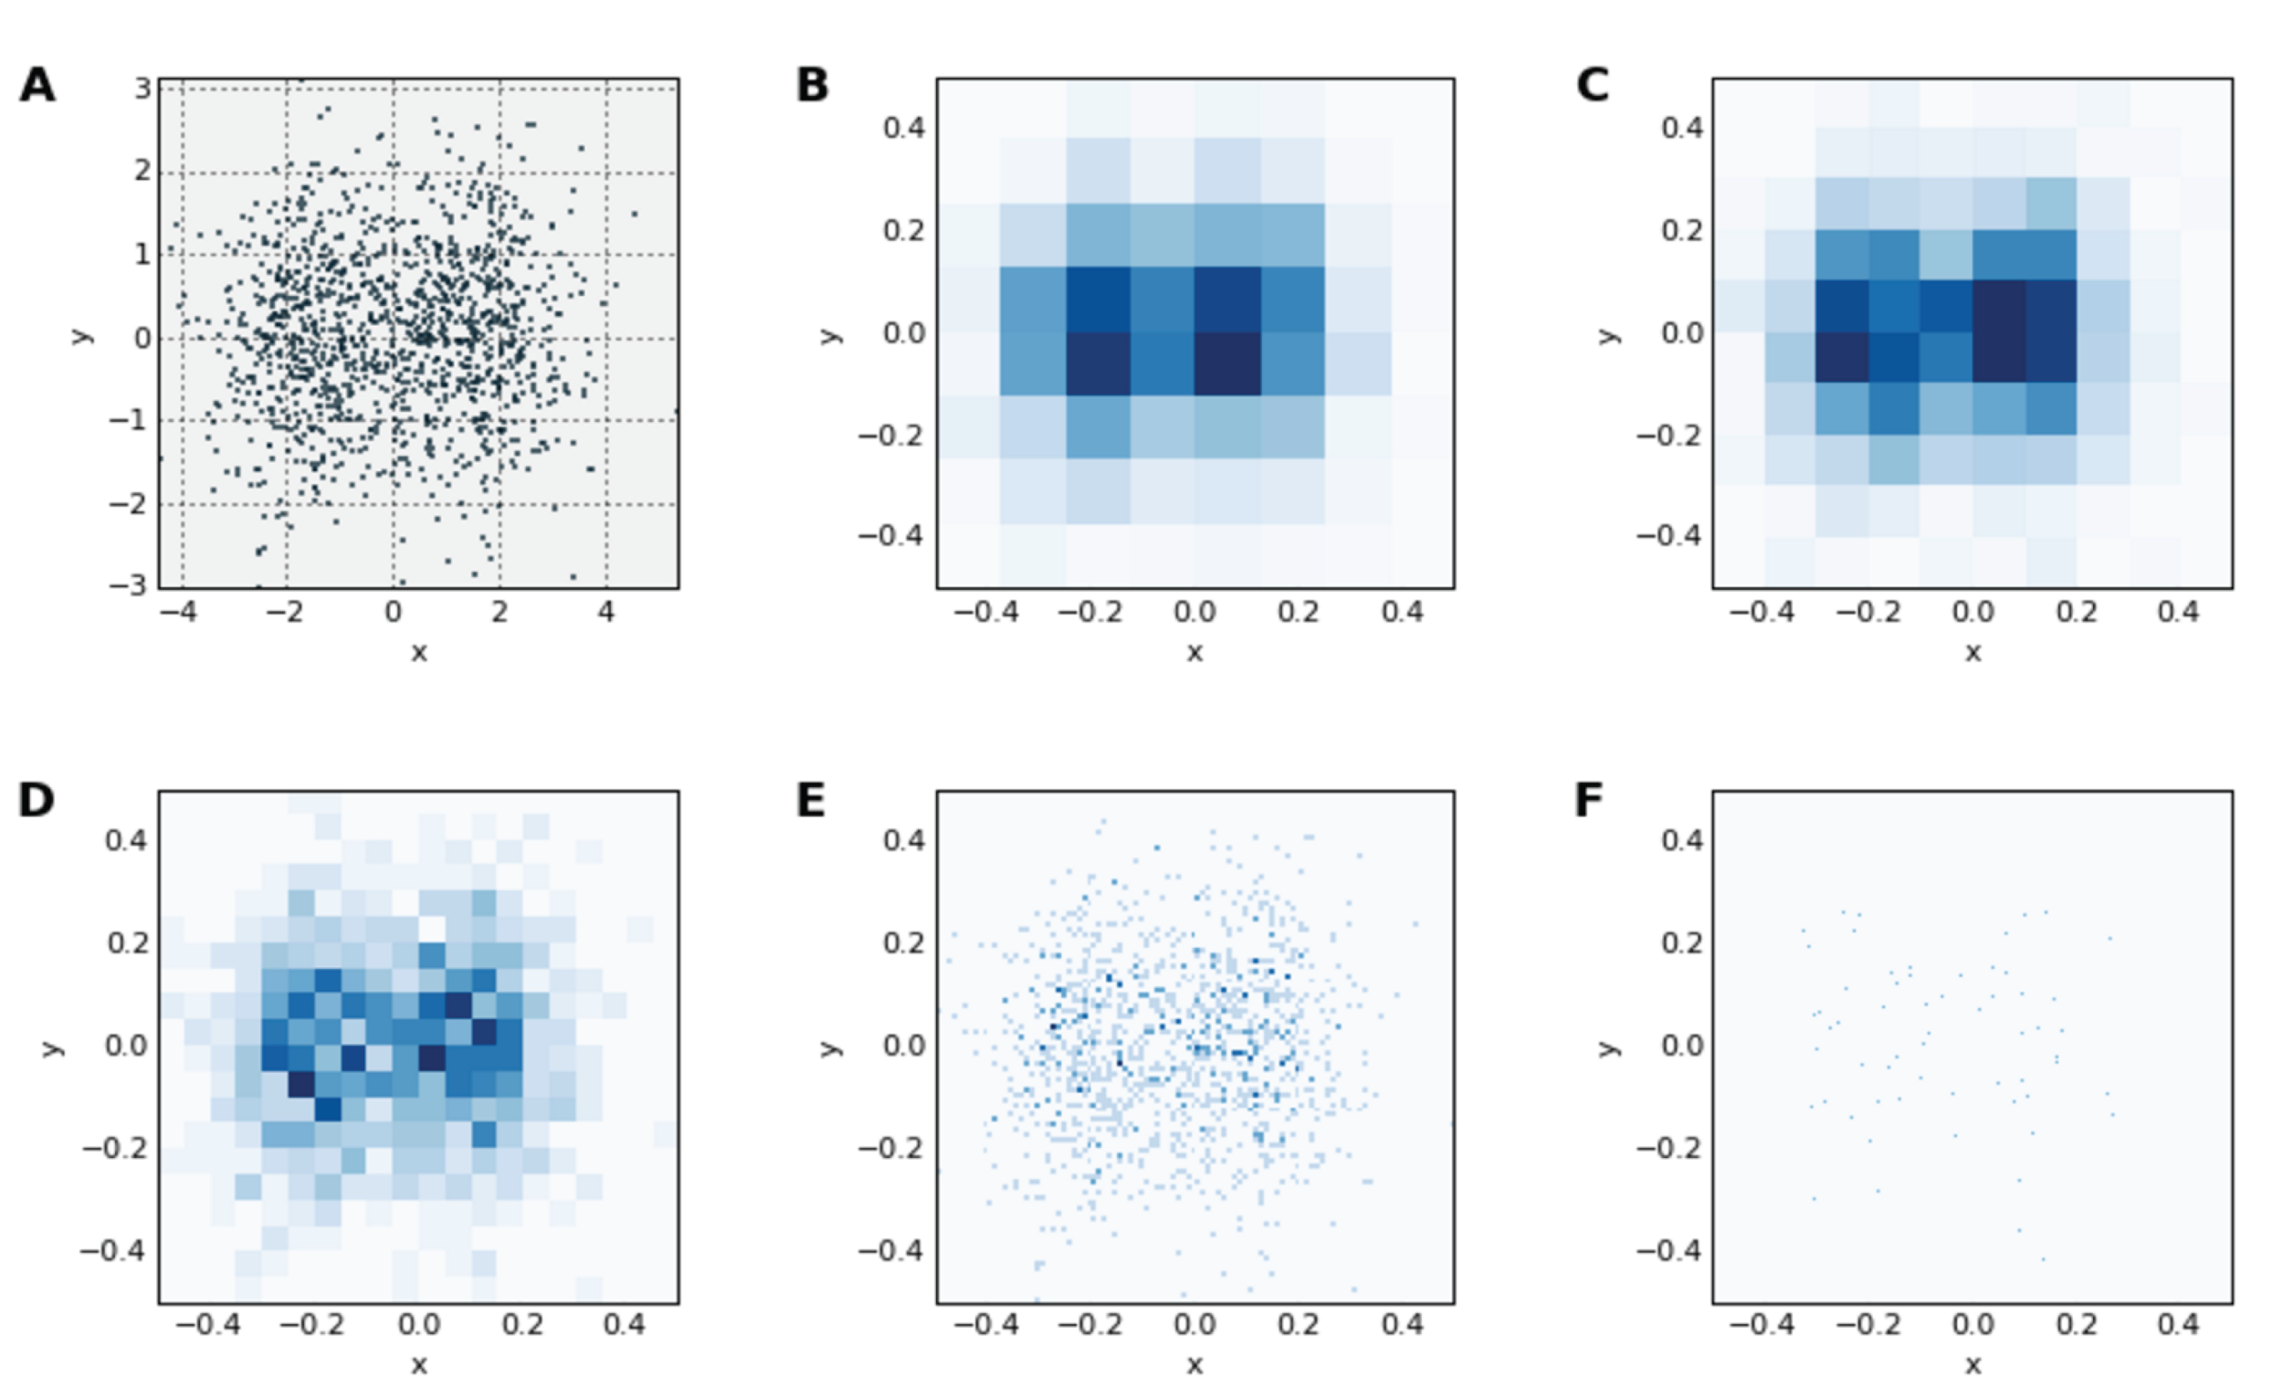
Common data-vis problems (binning)
how many bins or pixels should represent a data point
tricky to set the right binning
two merged normal distributions look different under different binning
Solution:
heatmaps + scale/data-shading and zooming in/out
Python Data Visualization @ Deepnote (w/ PyViz overview)
16/16 #PythonDay @ sli.do

Slide 22
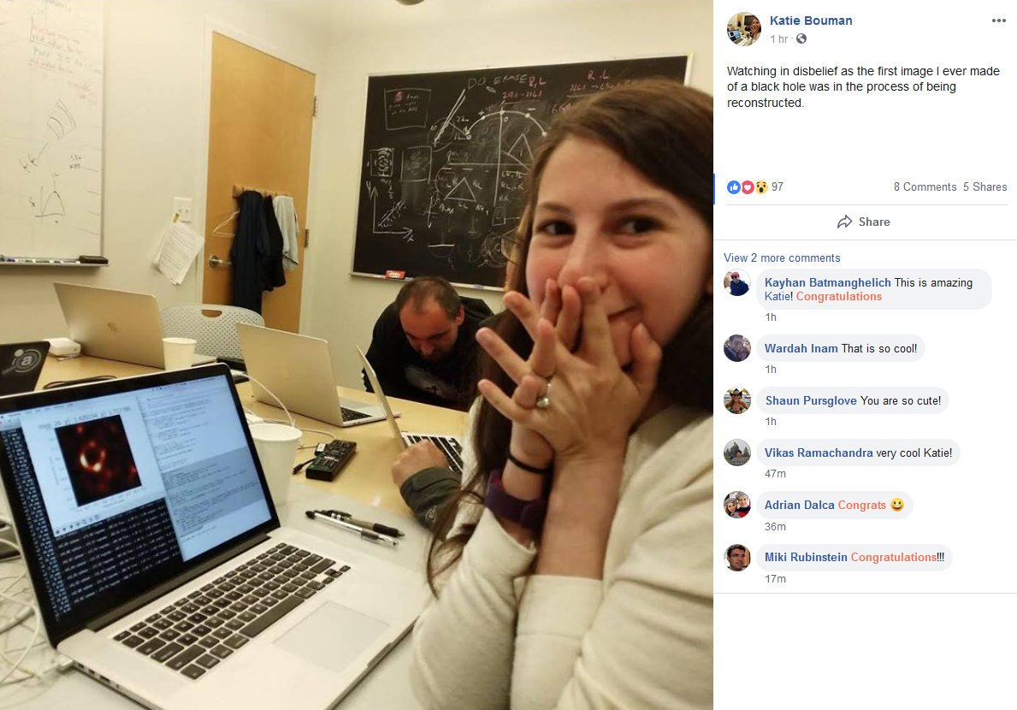
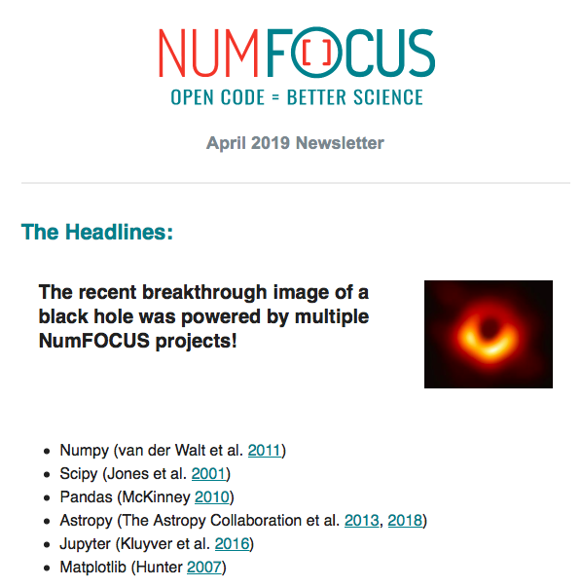
GapData Institute (GDI) and how to support us.
Economic Research & Public Policy & Data Science think-tank (data-tank)
Data. Think. Change.
GapData Institute (GDI) is a non-profit nonpartisan research institution harnessing power of data & wisdom of economics for public good.
Dr. Katherine Bouman
Python Data Visualization @ Deepnote (w/ PyViz overview)
#PythonDay @ sli.do
Notes:
(1-2 min.)
Basic information about GapData Institute
Economic Research & Public Policy & Data Science think-tank (data-tank)
Data. Think. Change.
GapData Institute (GDI) is a non-profit nonpartisan research institution harnessing power of data & wisdom of economics for public good.
Transparent account (from day #1; SK7383300000002200933920 https://www.fio.sk/ib2/transparent?a=2200933920)
Partnership (openness, transparency)
Contact:
Radovan Kavicky
radovan.kavicky@gapdata.org
+421 949 716 214 (SK)
http://www.linkedin.com/in/radovankavicky
https://gapdata.slack.com/messages/py-data/
https://github.com/radovankavicky
https://github.com/GapData/PyDataBratislava
@radovankavicky, @PyDataBA, @GapDataInst

Slide 23
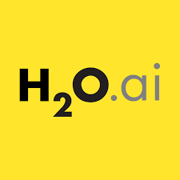

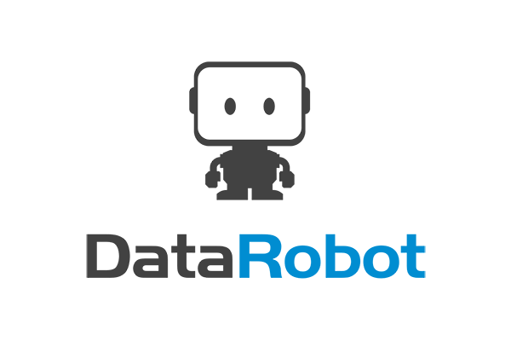

Future of DataViz (in Python too) ML/AI (NLP and voice)
- AI/ML augmented analytics (scenarios for data-driven decision making), BI & AI worlds will collide
- build and deploy highly accurate machine learning models without writing a single line of code and transparent/viz too
- experiment, simulate and compare different scenarios using various models/scenarios to identify the best strategy or test ideas before committing resources, voice & text interaction
- focus on the right data to analyze, get predictive insights with explanations in your dashboards, H2O.ai AutoViz (Leland Wilkinson/ex-Tableau)
- run simulations to get actionable prescriptive guidance on what to do next and get instant visual response
- Alphaa.ai (world’s 1st AI voice analyst/not regular “chatbot”)
In past we could use:
- TabPy (connect to Tableau Server from Python)
- Rserve (TCP/IP binary R server)
Python Data Visualization @ Deepnote (w/ PyViz overview)
#PythonDay @ sli.do
Notes:
(1-2 min.)

Slide 24
What's the future of Data Viz & Science according to you?
ⓘ Start presenting to display the poll results on this slide.
Python Data Visualization @ Deepnote (w/ PyViz overview)
#PythonDay @ sli.do
Notes:
📣 This is Slido interaction slide, please don't delete it. ✅ Click on 'Present with Slido' and the poll will launch automatically when you get to this slide.

Slide 25





PyData Slovakia/Bratislava & activities within CEE + V4
2000+ members
5000+ on mailing list
900+ followers
Partners: O'Reilly, NexTech, robime.it, Learn2Code, sli.do
Sponsors: H2O.ai, SwissRe, Kiwi.com
WeAreDevelopers World Congress (“GAPDATA-25” & “PYDATA-25”), Berlin/Vienna
OSCON 2021 (“PCGAPDATA” for 25% discount)
Our Conferences (satRday, PyData Slovakia)
Python Data Visualization @ Deepnote (w/ PyViz overview)
#PythonDay @ sli.do
Notes:
(1-2 min.)
Basic information about GapData Institute
Economic Research & Public Policy & Data Science think-tank (data-tank)
Data. Think. Change.
GapData Institute (GDI) is a non-profit nonpartisan research institution harnessing power of data & wisdom of economics for public good.
Transparent account (from day #1; SK7383300000002200933920 https://www.fio.sk/ib2/transparent?a=2200933920)
Partnership (openness, transparency)
Contact:
Radovan Kavicky
radovan.kavicky@gapdata.org
+421 949 716 214 (SK)
http://www.linkedin.com/in/radovankavicky
https://gapdata.slack.com/messages/py-data/
https://github.com/radovankavicky
https://github.com/GapData/PyDataBratislava
@radovankavicky, @PyDataBA, @GapDataInst

Slide 26



GapData Institute (GDI) and how to support us.
Economic Research & Public Policy & Data Science think-tank (data-tank)
Data. Think. Change.
GapData Institute (GDI) is a non-profit nonpartisan research institution harnessing power of data & wisdom of economics for public good.
Transparent account (from day #1; SK7383300000002200933920 https://www.fio.sk/ib2/transparent?a=2200933920)
Partnership (openness, transparency)
Slides (this talk): tiny.cc/WeAreDevsPython2021
https://github.com/radovankavicky/WeAreDevs2021
Deepnote (Live-Code) > http://bit.ly/PythonDayDeepnote
Python Data Visualization @ Deepnote (w/ PyViz overview)
#PyDataSK #PyDataBA
Notes:
(1-2 min.)
Basic information about GapData Institute
Economic Research & Public Policy & Data Science think-tank (data-tank)
Data. Think. Change.
GapData Institute (GDI) is a non-profit nonpartisan research institution harnessing power of data & wisdom of economics for public good.
Transparent account (from day #1; SK7383300000002200933920 https://www.fio.sk/ib2/transparent?a=2200933920)
Partnership (openness, transparency)
Contact:
Radovan Kavicky
radovan.kavicky@gapdata.org
+421 949 716 214 (SK)
http://www.linkedin.com/in/radovankavicky
https://gapdata.slack.com/messages/py-data/
https://github.com/radovankavicky
https://github.com/GapData/PyDataBratislava
@radovankavicky, @PyDataBA, @GapDataInst

Slide 27
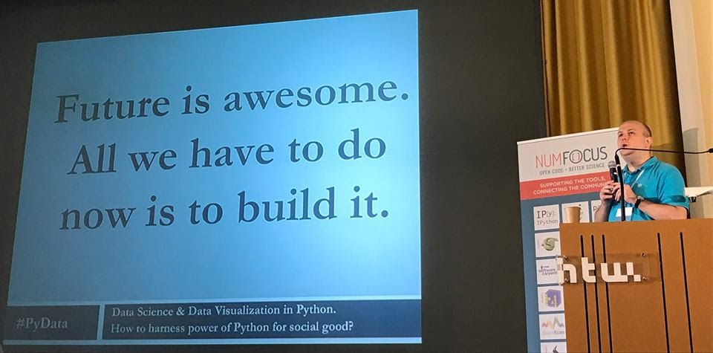
Future is awesome. All we have to do now is to build it.
Source: PyData Berlin 2017, Talk on YouTube: https://www.youtube.com/watch?v=I5578BhU4sE
Python Data Visualization @ Deepnote (w/ PyViz overview)
#PyDataBLN
Notes:
(1-2 min.)
Basic information about GapData Institute
Economic Research & Public Policy & Data Science think-tank (data-tank)
Data. Think. Change.
GapData Institute (GDI) is a non-profit nonpartisan research institution harnessing power of data & wisdom of economics for public good.
Transparent account (from day #1; SK7383300000002200933920 https://www.fio.sk/ib2/transparent?a=2200933920)
Partnership (openness, transparency)
Contact:
Radovan Kavicky
radovan.kavicky@gapdata.org
+421 949 716 214 (SK)
http://www.linkedin.com/in/radovankavicky
https://gapdata.slack.com/messages/py-data/
https://github.com/radovankavicky
https://github.com/GapData/PyDataBratislava
@radovankavicky, @PyDataBA, @GapDataInst

Slide 28
How did you like this talk? (It was: 1 star/low, 2 stars/ok, 3 stars/meh/average, 4 stars/high, 5 stars/awesome)
ⓘ Start presenting to display the poll results on this slide.
Python Data Visualization @ Deepnote (w/ PyViz overview)
#PythonDay @ sli.do
Notes:
📣 This is Slido interaction slide, please don't delete it. ✅ Click on 'Present with Slido' and the poll will launch automatically when you get to this slide.

Slide 29


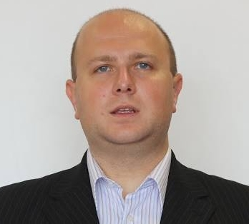




Slides (this talk): tiny.cc/WeAreDevsPython2021
https://github.com/radovankavicky/WeAreDevs2021
Deepnote (Live-Code) > http://bit.ly/PythonDayDeepnote
Thank you for your attention
Contact:
Radovan Kavicky
radovan.kavicky@gapdata.org
radovan.kavicky@gmail.com
+421 949 716 214 (SK)
http://www.linkedin.com/in/radovankavicky
https://gapdata.slack.com/
Invitations (e-mail): https://gapdata.herokuapp.com/
https://github.com/radovankavicky
FB: https://www.facebook.com/groups/356635138031671
@radovankavicky, @PyDataBA, @GapDataInst
In case you have any question, feel free to ask.
#wearedevslive @ sli.do
Notes:
Contact:
Radovan Kavicky
radovan.kavicky@gapdata.org
+421 949 716 214 (SK)
http://www.linkedin.com/in/radovankavicky
https://gapdata.slack.com/messages/py-data/
https://github.com/radovankavicky
https://github.com/GapData/PyDataBratislava
@radovankavicky, @PyDataBA, @GapDataInst

Slide 30


Oh, and one more thing… :)
Meetup.com
https://www.meetup.com/Julia-Users-Group-Slovakia/
Facebook
https://www.facebook.com/groups/379292635993253/
Hashtag: #JUGSlovakia
More to come... soon. Stay tuned.
Python Data Visualization @ Deepnote (w/ PyViz overview)
#wearedevslive @ sli.do
Notes:
(1-2min.)
Data Science (Urban) + Data Visualization
OSMnx
- https://github.com/gboeing/osmnx
CARTO.com (maps + predictions)
QGIS.org (Open Source GIS)
Tableau Desktop 10.2 (interactive DataViz)
OpenStreetMap.org
Openlayers.org
Leaflet (JS, R + maps +ggmap)
Mapbox (3D maps/C++, OpenGL)
Google fusion tables
OSMnx Python for street networks
Retrieve, construct, analyze, and visualize street networks from OpenStreetMap: full overview.
OSMnx is a Python 2+3 package that lets you download spatial geometries and construct, project, visualize, and analyze street networks from OpenStreetMap's APIs. Users can download and construct walkable, drivable, or bikable urban networks with a single line of Python code, and then easily analyze and visualize them:
So how will 'smart' cities help us deal with tackling climate change and growth at the same time? There are 5 key areas emerging for 'smart' services that enable a sustainable, low carbon city.
1. Monitoring and managing the "footprint" of the city for decision-makers 2. Connected mobility solutions to enable modal shift, and electric vehicles 3. Distributed and community energy solutions 4. Smarter buildings that are transparent about energy consumption, use and generation 5. Smart energy, water and waste management
Behind these key areas are technology solutions like 'smart meters' and the 'smart grid', which have been widely covered in the news.
But how much more efficient could we really make our lifestyles, today? Could we turn down the office heating without sacrificing comfort? Could we work flexibly, modify our travel patterns, and still achieve the business and mobility services we have come to rely on?

